Slide 1
CS 451 - Battle Boats
Joe Muoio, Cory Bergquist, Peter Liu, Michael Bonawitz, Kevin Zakszewski

Slide 2
Roles
Cory Bergquist - Administrator
Michael Bonawitz - Programmer
Peter Liu - UI Specialist
Joseph Muoio - Chief Architect
Kevin Zakszewski - Tester/Scribe

Slide 3
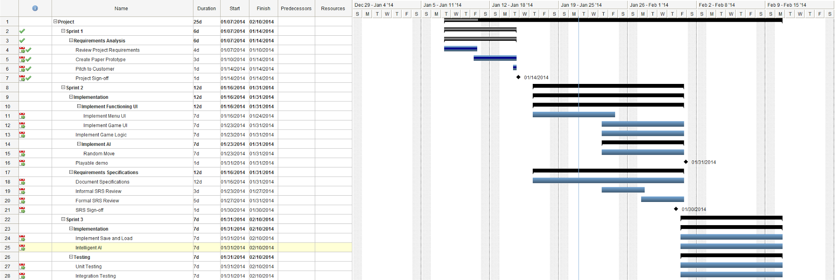

Slide 4
Battle Boats
New Game
Load Game
Exit

Slide 5
Load Game
Saved Game 12-25-13: 10:53
Saved Game 02
Saved Game 03

Slide 6
New Game
vs. Player
vs. Computer
Back

Slide 7
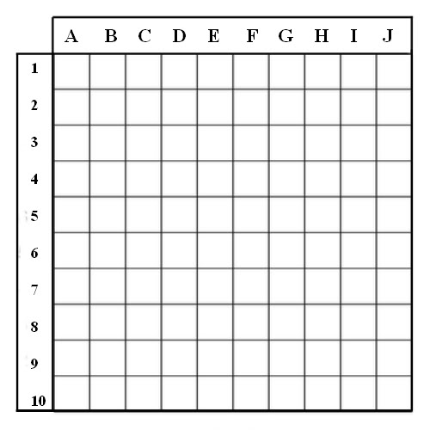
Player 1
placing5 Ships Remain
Done

Slide 8
Player 1
placing5 Ships Remain
Done

Slide 9
Player 1
placing4 Ships Remain
Random
Done

Slide 10
Player 1
placing0 Ships Remain
Random
Done

Slide 11
Player 2
placing5 Ships Remain
Random
Done

Slide 12
Player 1 turn
Okay

Slide 13
Player 1 attacking
Surrender
Save
Done

Slide 14
Player 1 attacking
Surrender
Save
Done

Slide 15
Player 1 attacking
Surrender
Save
Done

Slide 16
Player 2 turn
Okay

Slide 17
Player 2 attacking
Surrender
Save
Done

Slide 18
Player 2 attacking
Surrender
Save
Done

Slide 19
Player 2 attacking
Surrender
Save
Done

Slide 20
Player 2 attacking
Surrender
Save
Done

Slide 21
Surrender?
Yes
No

Slide 22
Player 1 Wins!
Okay

Slide 23
Save Game
Overwrite: Saved Game 12-25-13: 10:53
New Saved Game
New Saved Game

